Slide 1


PONG GAME
BVRIT HYDERABAD College of Engineering for Women
Department of Information Technology
Student 1: P. Keerthana Student 2: R. Laya sree Student3: V. Gayathri Student4: S. Rishika
Roll no: 24WH1A6656 Roll no: 24WH1A6657 Roll no: 24WH1A6658 Roll no: 24WH1A6659
Under the Guidance of
Ms.B.Shanmukha Priya
Assistant Professor,
Dept of C.S.E (AI &ML),
BVRIT Hyderabad Collage of Engineering for Women.
June 12, 2025
Mini Project with Seminar 22WH1DBXXX

Slide 2
CONTENTS
ABSTRACT
INTRODUCTION
LITERATURE REVIEW
TECHNOLOGY STACKS
OUTPUTS/IMAGES
REFERENCES
Mini Project with Seminar 22WH1DBXXX

Slide 3

ABSTRACT
This digital recreation of the classic Pong arcade game demonstrates core programming concepts through interactive gameplay. Built with Python and Pygame, the implementation features player-controlled paddles, ball physics, and score tracking. The system utilizes real-time collision detection between moving objects and screen boundaries, with keyboard input handling for responsive controls. A simple AI opponent follows basic ball-tracking logic.
The game employs object-oriented design principles, maintaining consistent performance through frame-rate independent calculations. Vector-based movement creates realistic ball trajectories that change upon paddle contact. This project serves as an accessible introduction to game development, showcasing fundamental techniques while preserving the original game's simplicity. Clean code architecture allows for easy modification and extension.

Slide 4
INTRODUCTION
Pong is one of the earliest and most iconic arcade video games, originally developed and released by Atari in 1972. It simulates a simple game of table tennis, where two players control paddles on either side of the screen, using them to hit a ball back and forth. The main objective is to prevent the ball from passing your paddle while trying to score points by getting it past your opponent’s. Despite its minimal graphics and straightforward gameplay, Pong played a groundbreaking role in the history of video games, marking the beginning of the commercial gaming industry. In this project, we have recreated the classic Pong using Python and the Pygame library, adding vibrant visuals and smooth interactions while preserving the charm of the original

Slide 5

LITERATURE REVIEW
Author | Title/Source | Year | Key contributions
Bushnell, N. & Alcorn, A. | The First Commercial Video Game (Atari) | 1972 | Designed and released Pong, the first commercially successful arcade game; laid foundation for the gaming industry.
Donovan, T. | The History of Video Games | 2010 | Documented the evolution of video games; highlighted Pong as a turning point in interactive entertainment.
Kent, S. L. | The Ultimate History of Video Games | 2001 | Explored the creation of Pong and its cultural impact; credited for pioneering the arcade industry.
Williams, D. | The Legacy of Pong | 2006 | Analyzed Pong’s technical design and minimalistic mechanics that influenced game design principles.

Slide 6
TECHNOLOGY STACKS
Programming Language: Python
Game Library: Pygame
IDE: VS Code / PyCharm
OS: Windows/Linux/MacOS
Optional: Git for version control

Slide 7

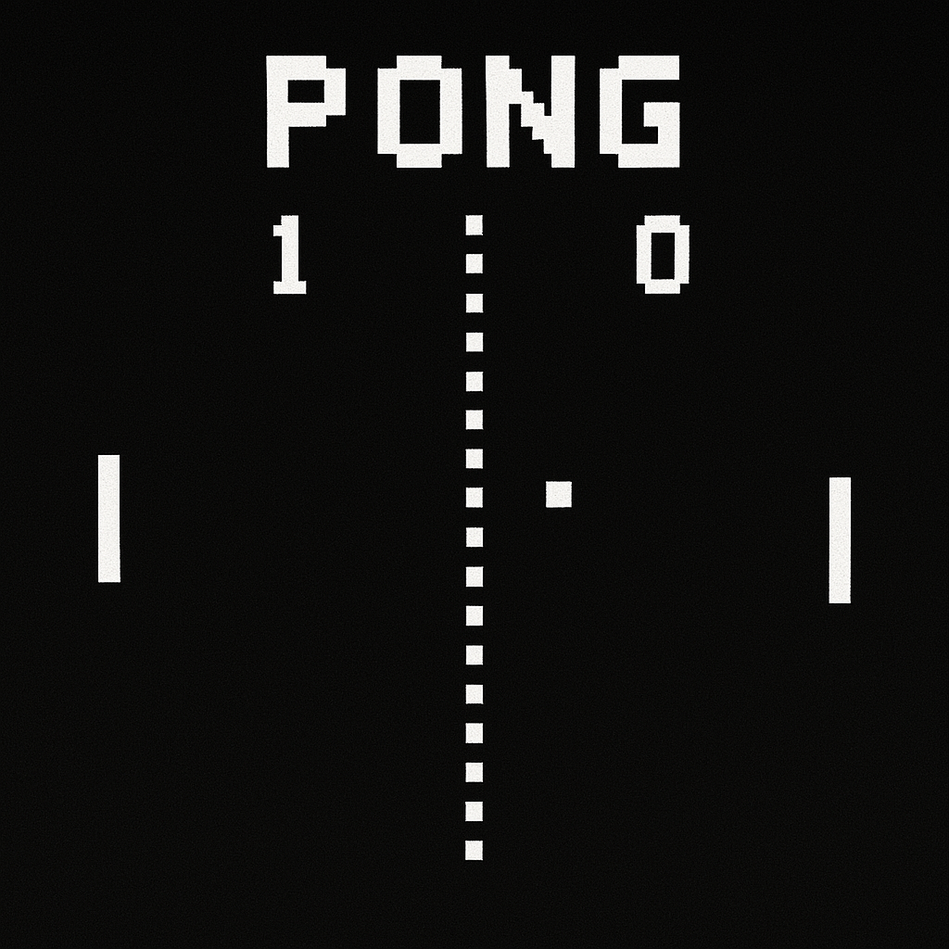
OUTPUTS AND IMAGES
Pong is a two-player arcade game where each player controls a paddle to hit the moving ball back and forth

Slide 8
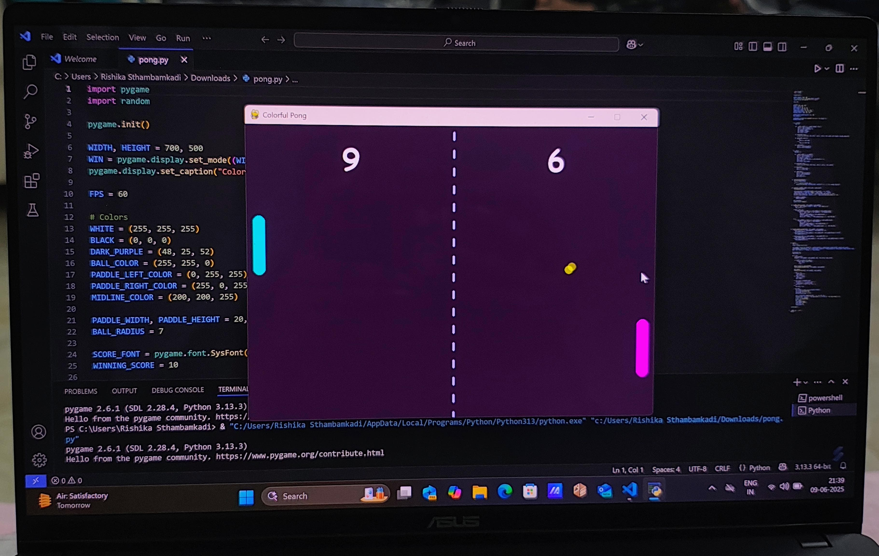
The goal is to score points by making the opponent miss the ball, while the game showcases basic collision and motion logic using Python and Pygame

Slide 9
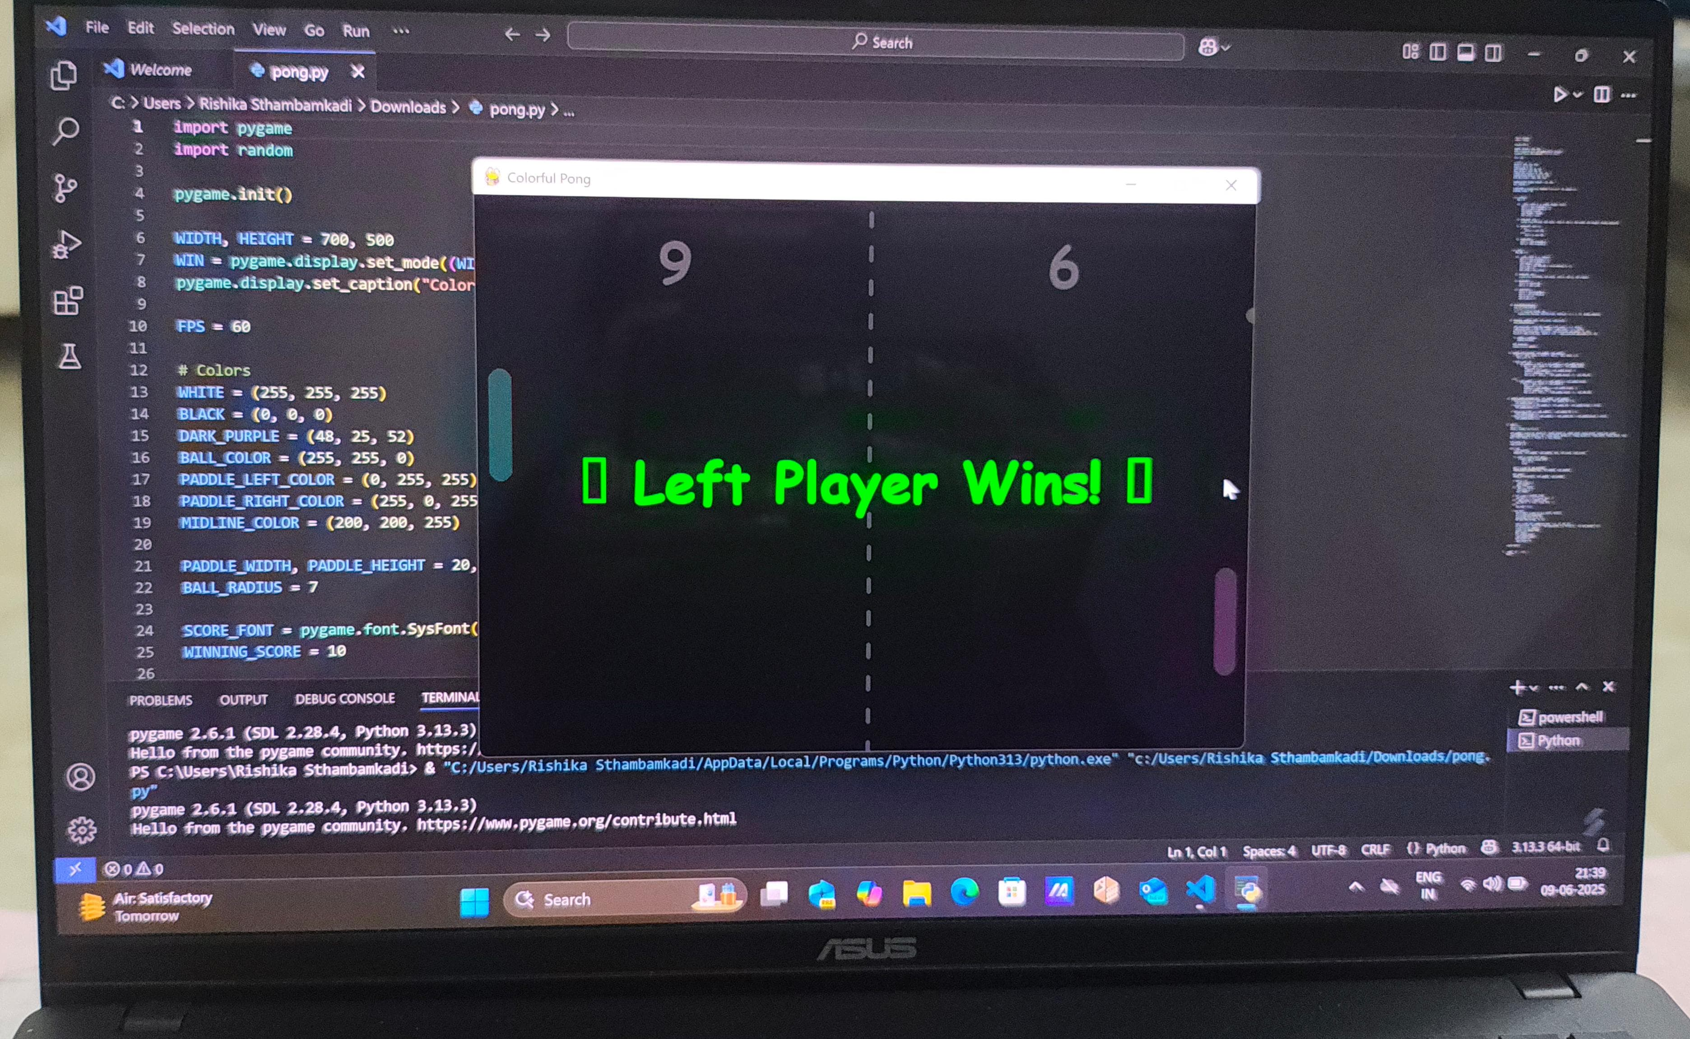
The game ends when a player reaches the winning score. A victory message is displayed, celebrating the winner based on final scores.

Slide 10
REFERENCES
Bushnell, N., & Alcorn, A. (1972). Pong: The first commercial video game [Arcade game].
Atari Inc. Donovan, T. (2010). Replay: The history of video games. Yellow Ant.
Kent, S. L. (2001). The ultimate history of video games: From Pong to Pokémon and beyond—The story behind the craze that touched our lives and changed the world. Three Rivers Press.
ACM SIGGRAPH. (2006). The legacy of Pong. Proceedings of the ACM SIGGRAPH Video Game Symposium, 48(3), 55–59.
Williams, D. (2003). Video games and the future of learning. Journal of Educational Multimedia and Hypermedia, 12(1), 117–131.
Wolf, M. J. P. (2008). The video game explosion: A history from PONG to PlayStation and beyond. Greenwood Press.
Herz, J. C. (1997). Joystick Nation: How video games ate our quarters, won our hearts, and rewired our minds. Little, Brown and Company.

Slide 11

THANK YOU

